Slide 1
Introduction to SIEMs using Splunk
SIEMs Unit, Day 1

Slide 2
Class Objectives
By the end of class today, students will be able to:
Recognize the role SIEMs play in protecting an organization's security.
Explain how logs are filtered, normalized, and correlated for events.
Demonstrate how to use basic features of the Splunk User Interface.
Explain basic database terms and query functions.
Use the Splunk Processing Language (SPL) for simple queries.

Slide 3
Introduction to SIEMS

Slide 4
What are SIEMs?
The Scenario:
An organization's IT infrastructure has a variety of systems and applications on their networks, including host systems, product applications, network devices, firewalls, etc.
The Problem:
The Solution:

Slide 5
What are SIEMs?
The Scenario:
An organization's IT infrastructure has a variety of systems and applications on their networks, including host systems, product applications, network devices, firewalls, etc.
The Problem:
It’s challenging for organizations to have full visibility of their network, making suspicious behavior more difficult to detect.
The Solution:

Slide 6
What are SIEMs?
The Scenario:
An organization's IT infrastructure has a variety of systems and applications on their networks, including host systems, product applications, network devices, firewalls, etc.
The Problem:
It’s challenging for organizations to have full visibility of their network, making suspicious behavior more difficult to detect.
The Solution:
Organizations use SIEMs (Security Information and Event Management) to monitor odd behavior and irregular traffic on their network, allowing infosec teams to detect suspicious activity.

Slide 7
SIEMS
A SIEM connects and unifies the information from various sources, allowing data to be analyzed and cross referenced.
Security Devices
Servers and Hosts
Network & Virtual Activity
Event Correlation
Database Activity
Identification
Application Activity
Activity Baselining &
Anomaly Detection
Configuration Info
Vulnerability Info
User Activity

Slide 8
SIEMS
A SIEM connects and unifies the information from various sources, allowing data to be analyzed and cross referenced.
SIEMs provide real-time monitoring of machine data to correlate events, baselines, notifications, alerts, reports and visualization.
SIEMs do not support security analytics, which create behaviors and profiles using machine learning and applies statistical analysis to detect anomalies that could indicate potential threats.

Slide 9
The Benefits of SIEMS
Using SIEMs provides the following benefits:
Increased efficiency
Prevention of potential security threats
Reduced impact of security breaches
Reduced costs
Better reporting, log analysis, and retention
IT Compliance
Notes:
Increased efficiency: Organizations can use SIEMs to gather and monitor a large amount of logs in one place using a simple interface.
Preventing potential security threats: SIEMS monitor and alert on suspicious activity in the logs. Organizations can get notified early of potential threats by reducing the mean time to detect (MTTD) and the mean time to respond (MTTR) to cyber threats.
Reducing the impact of security breaches: Review of logs will show certain areas of the network that may need additional security controls which can be put in place to mitigate or even stop a breach.
Reducing costs: One central system is used to view, monitor, and alert. Organizations can reduce costs on hardware and software.
Better reporting, log analysis, and retention: One system collects all of the logs and makes it easier to generate reports and analyze logs.
IT compliance: The depth of visibility into the logs makes its possible for organizations to see if they remain compliant.

Slide 10
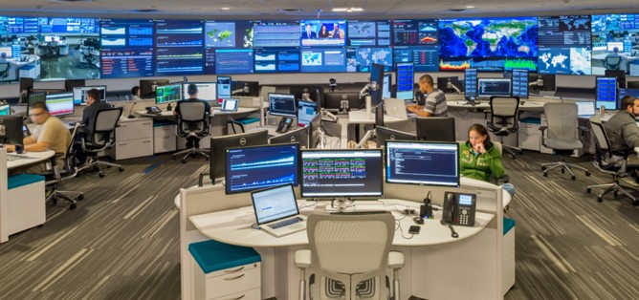
SIEMs Use-Cases
Security Operations Center (SOC) and Security Analysts (SA) Teams use SIEMs to analyze data in order to detect malicious cyber attacks across devices, systems, applications and network infrastructures. In this context, SIEMs are used for:
Threat Hunting:
Developing and testing a hypothesis by exploring logs and searching data for security patterns similar to current incidents.
Detecting Data Exfiltration:
Detecting emails sent to persons other than
the intended recipient.
Identifying and reporting on excessive print and
send alerts to trouble ticket systems.

Slide 11
SIEMs Use-Cases
Security Operations Center (SOC) and Security Analysts (SA) Teams use SIEMs to analyze data in order to detect malicious cyber attacks across devices, systems, applications and network infrastructures. In this context, SIEMs are used for:
Internet of Things (IoT) Security
Identifying unusual traffic that results in Denial of Service (DoS) attacks.
Identifying suspicious behavior on devices.
Privileged Access Abuse
Monitoring suspicious access to sensitive data.
Reporting on users that are accessing data outside
their regular profile.
Reporting on activity of terminated user accounts.

Slide 12
SIEMS is not one single application…
Like Linux distributions, SIEMS are a class of tools that come in a variety of products and vendors depending on a user’s specific need.

Slide 13

Student Activity: SIEM Vendor Research
In this activity, you will research other SIEM vendor options.
Although we’ll focus on Splunk today, it is
important to familiarize yourself with a variety of SIEM products and vendors.
15 minutes

Slide 14
Your Turn! SIEM Vendor Research
Instructions:
Break out into groups of 2-3 students.
Using Google, research 3-5 SIEM vendors (besides Splunk).
List the following information:
- Company Name
- Product Name
- Capabilities (Advantages/Disadvantages)

Slide 15
SIEM Vendor Research Review
Top SIEM Vendors
•••• Best ••• Very Good •• Good • Fair
Threats Blocked | Sources Ingested | Performance | Value | Implementation | Management | Support | Scalability
•••• | ••• | ••• | ••• | •• | ••• | •• | •••
••• | •••• | ••• | •• | ••• | ••• | ••• | ••
••• | ••• | ••• | •••• | ••• | •• | •• | •••
•• | ••• | ••• | •• | ••• | •••• | •• | •••
•• | •• | •• | ••• | ••• | ••• | •• | •••
••• | ••• | ••• | ••• | •• | •• | ••• | •••
••• | ••• | ••• | ••• | •• | ••• | •• | ••••
••• | ••• | •••• | ••• | •• | ••• | ••• | •••
•• | •• | ••• | •• | •• | •• | ••• | •••
•• | ••• | •• | •• | •••• | •• | ••• | ••
splunk > ES
LogRhythm
ALIEN VAULT
MICRO
FOCUS
ArcSight
MICRO
FOCUS
Sentinel
McAfee ESM
Trustwave SIEM
IBM QRadar
RSA NetWitness
solarwind LEM
Notes:
Recreated chart: eSecurityPlanet.net

Slide 16

Logs, Events, Analysis and Response
Now, we’ll focus on how log data is processed and analyzed as events.
Server Logs
System Logs
SIEMS
Rule-based Correlation
Emails Alerts
Reports Dashboards
Raw Log Data
Events
Actions
Normalize Log Data
Statistical Correlation
Long-Term Storage
Notes:
Chart recreated

Slide 17
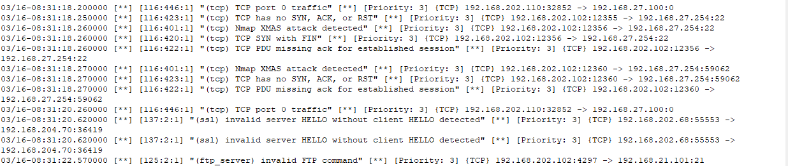
How do SIEMs Parse, Identify, and Assist in Event Analysis
Collecting Raw Log Data
Raw log data is collected in real-time from various sources.
Below is an example of TCP, SSL, and FTP events from a network log.

Slide 18
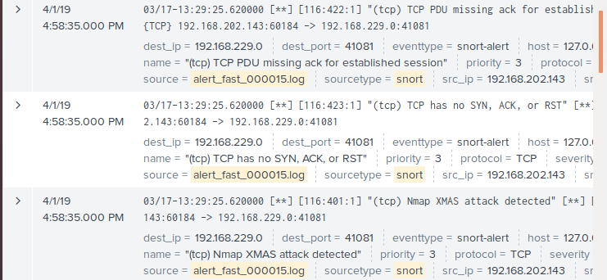
How do SIEMs Parse, Identify, and Assist in Event Analysis
Normalize Raw Log Data
The raw log data is mapped to various elements, such as source and destination IP in order to produce a common format or metadata for event types.
The data is indexed. Extended term storage is provided for both raw and event data.
Right: For example, in this event, the destination ip and destination port have been parsed, identified and labeled.

Slide 19
How do SIEMs Parse, Identify, and Assist in Event Analysis
Correlate Event and State Data
Correlation is the driver for analysis and the actions.
SIEMs capture state data which differentiates SIEMs from log management systems.
State data is information regarding the full state of a system: configurations, current applications, active users, processes, registry settings and vulnerabilities.
Understanding the full state of the system is the foundation for all security-related decisions.
Event correlation is the process of finding relationships between seemingly unrelated events in data.
We can use rules and statistical analysis to correlate data.

Slide 20
Rules-based Event Correlation
A SIEM correlation rule indicates which sequence of events could be indicative of anomalies.
A connection event
AND
A failed login event
AND
An application launched in some place in the system
Action: Create an Alert
This may be a system compromise or insider abuse of system privileges.

Slide 21
Statistical Event Analysis
Statistical analysis can be used to flag more latent data and events that resemble other events.
Statistical methods use tools like:
Frequencies
Baselines
Thresholds
Statistical data can also be visualized using charts, dashboards, metrics, and other methods.
Let’s take a look at some statistical techniques...

Slide 22
Statistical Techniques
Frequencies, in general, are an event’s number of occurrences in a specific period of time.
In SIEMs, frequencies are useful because we can count source and destination IP addresses in an incoming log across all log sources.
For example, a spike in the number of occurrences of a destination IP address can be an early warning sign that someone is targeting an attack on this system.

Slide 23
Statistical Techniques
Baselines provide a measure of what is normal in a SIEMs data set.
Baselines are calculated over an elongated period of time.
Once the baseline is set, we can monitor unusual data that falls outside of the baseline. This data can serve as an early warning for targeted attacks to the system.
Baseline usage includes:
User logons and logoffs, both successful and failed.
Network traffic bytes, inbound and outbound.
Network traffic to particular ports, services and protocols.
Administrative account usage and access.
Processes running on a server.

Slide 24
Statistical Techniques
Thresholds are used for determining when something exceeds a baseline value.
For example: time and frequency thresholds include:
A server that normally receives an average of 20 failed logins per hour and is now receiving 50.
The number of hits on port 443 over the last week.
User logins to a server X times per day.
Use of su command per hour of day.

Slide 25
Activity: Working with Logs and Events
In this activity, you will review a log event in order to see data and understand the normalization process.
Instructions sent via Slack.
20 Minutes

Slide 26
Working with Logs and Events

Slide 27
Working with Logs and Events Review
Part 1:
1. List two benefits of using SIEMS:
2. How are logs used in a SIEMS?
3. What is a baseline and how is it used in a SIEMs

Slide 28
Working with Logs and Events Review
Part 1:
1. List two benefits of using SIEMS: Answers may include:
Increased efficiency; preventing potential security threats; reducing the impact of security breaches; reducing costs; better reporting log analysis, and retention; and IT compliance
2. How are logs used in a SIEMS?
3. What is a baseline and how is it used in a SIEMs

Slide 29
Working with Logs and Events Review
Part 1:
1. List two benefits of using SIEMS: Answers may include:
Increased efficiency; preventing potential security threats; reducing the impact of security breaches; reducing costs; better reporting log analysis, and retention; and IT compliance
2. How are logs used in a SIEMS?
SIEMs collect logs from different sources in real-time and security teams use the data to detect and respond to security incidents.
Log data is processed into events, which are then used in analysis.
3. What is a baseline and how is it used in a SIEMs

Slide 30
Working with Logs and Events Review
Part 1:
1. List two benefits of using SIEMS: Answers may include:
Increased efficiency; preventing potential security threats; reducing the impact of security breaches; reducing costs; better reporting log analysis, and retention; and IT compliance
2. How are logs used in a SIEMS?
SIEMs collect logs from different sources in real-time and security teams use the data to detect and respond to security incidents.
Log data is processed into events, which are then used in analysis.
3. What is a baseline and how is it used in a SIEMs
A baseline provides a measure calculated over an extended period of time in order to determine what is normal in a SIEMS data set.

Slide 31
Working with Logs and Events Review
Part 2: Use the sample log entry to find the following field names and values:
192.188.106.240 - - [06/Feb/2019:23:59:45]
"GET http://www.buttercupgames.com/category.screen?
categoryId=TEE&JSESSIONID=SD2SL4FF9ADFF4959 HTTP 1.1" 200 2958
Field names and values:

Slide 32
Working with Logs and Events Review
Part 2: Use the sample log entry to find the following field names and values:
192.188.106.240 - - [06/Feb/2019:23:59:45]
"GET http://www.buttercupgames.com/category.screen?
categoryId=TEE&JSESSIONID=SD2SL4FF9ADFF4959 HTTP 1.1" 200 2958
Field names and values:
client_ip = 192.188.106.240
timestamp = 06/Feb/2019:23:59:45
http_method = GET
http_url= GET http://www.buttercupgames.com/category.screen?categoryId=TEE&JSESSIONID=SD2SL4FF9ADFF4959 HTTP 1.1
status = 200
bytes = 2958

Slide 33
Working with Logs and Events Review
Part 3: Write a pseudocode statement(s) that checks if the GET request sent to the server was unsuccessful for the source IP address and the date in our sample log entry.

Slide 34
Working with Logs and Events Review
Part 3: Write a pseudocode statement(s) that checks if the GET request sent to the server was unsuccessful for the source IP address and the date in our sample log entry.
Potential Solution:
client_ip is equal to `192.188.106.240`
AND
timestamp is equal to `06/Feb/2019:23:59:45`
AND
status does not equal `200`

Slide 35
Working with Logs and Events Review
Extra Challenge: Send an alert if the count of unsuccessful GET responses are greater than 50 in one minute.
Potential Solution:

Slide 36
Working with Logs and Events Review
Extra Challenge: Send an alert if the count of unsuccessful GET responses are greater than 50 in one minute.
Potential Solution:
Store the count of unsuccessful responses in count
if count is greater than 50
AND
time is one minute
send an alert to the trouble ticket system

Slide 37

Break

Slide 38
Introduction to Splunk

Slide 39

What’s Splunk?
Splunk is a SIEM software platform used to search, analyze and visualize machine generated data gathered from websites, applications, sensors, and other devices that comprise a business’s IT infrastructure.
Splunk offers one single interface to view logs from many different sources in real time.

Slide 40


Splunk’s Interface
Splunk offers one single interface to view logs from many different sources in real time.
Splunk CLI
Splunk Web Interface
Other Interfaces
splunk > Engine
Scheduling / Alerting
Reporting
Knowledge
Distributed Search
Distributed Search
Search
Deployment Server
Index
User & Access Controls
Data Routing, Cloning, and Loading Balancing
Monitor Files
Detect Changes
Listen to Network Ports
Run Scripts

Slide 41
Splunk
Splunk’s Key Features and Functionality:
Analyze system performance
Troubleshoot failures
Monitor business metrics
Search and investigate a particular outcome
Create dashboards to visualize and analyze results
Store and retrieve data for later use

Slide 42
Splunk
Some benefits include the abilities to...
Input data in any format, like .csv, json, etc.
Splunk can be configured to give alert / event notifications at the onset of a machine state.
Splunk can accurately predict the resources needed for scaling up the infrastructure.
Create knowledge objects for Operational Intelligence.

Slide 43
Activating and Logging into Splunk

Slide 44
Activating Splunk
Your VM already contains the Splunk installation. However, in order to activate it, you will need to complete the following steps:
Open your terminal window:
Type: start_splunk
Type: Y (to accept the terms of service)
Type: student for the username
Type: cybersecurity for the password
Log into Splunk
Open a web browser
Navigate to:`http://127.0.0.1:8000` once Splunk has finished setting up.
Enter your username and password.
You’re now using Splunk!

Slide 45
Student Activity: Activate Splunk
Splunk should already be installed on your machines.
In this activity, you will activate and log into Splunk.
Instructions sent via Slack.
10 minutes

Slide 46
Your Turn! Activating Splunk
Instructions
Your VM already contains the Splunk installation. However, in order to activate it, you will need to complete the following steps:
Open your terminal window:
Type: start_splunk
Type: Y (to accept the terms of service)
Type: student for the username
Type: cybersecurity for the password
Log into Splunk
Navigate to:`http://127.0.0.1:8000` once Splunk has finished setting up.
Enter your username and password.

Slide 47
Splunk User Interface

Slide 48
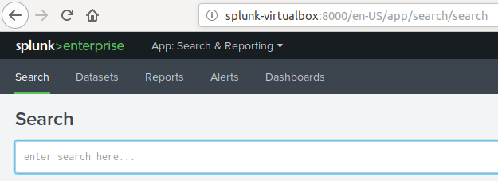
Introduction to the Splunk User Interface
The Search & Reporting Application is the primary interface for running searches, saving reports, and creating alerts and dashboards.

Slide 49
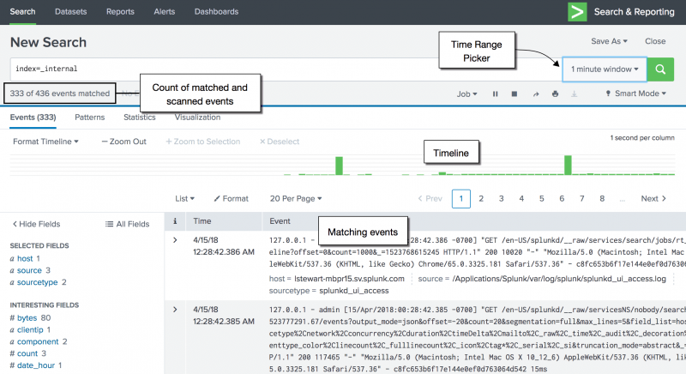
Search
The Search option provides the ability to search events from indexed data .
(For example: Windows event logs, web server logs, live application logs, network feeds.)
Security teams run a series of time-based searches to investigate and identify abnormal activity.
The timeline is used to drill into specific time periods (minutes, hours, days) in order to correlate events that occur around the same time.

Slide 50
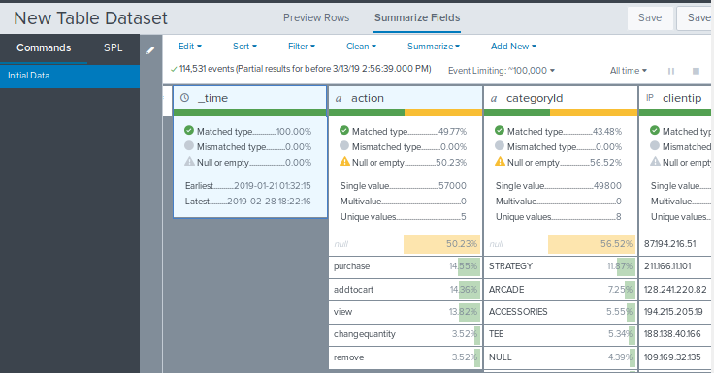
Datasets
A dataset is a collection of data that is defined and maintained for a specific business purpose.
Datasets are used when:
1. You do NOT know the Search Processing Language (SPL).
2. You want to avoid spending time designing complicated searches.
Datasets are created using a Table Editor in which events fields are selected for a search.

Slide 51
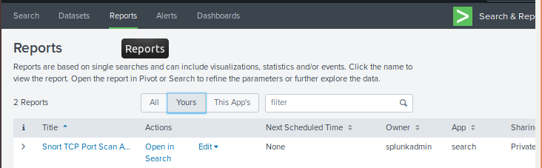
Reports
Reports are created when you save a search. They can also be created manually. They can be scheduled to run at intervals and used in the dashboard.
PDF documents can also be generated from reports.

Slide 52
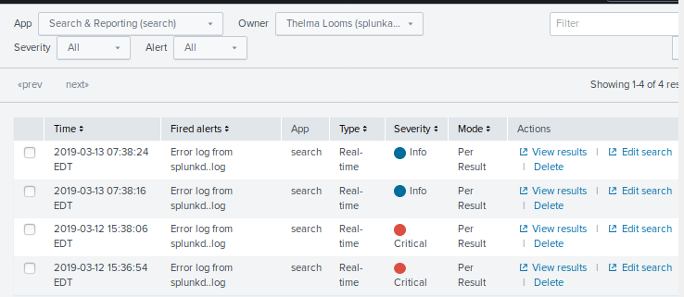
Alerts
Alerts are used to monitor for and respond to specific events.
They can look for events in real time or on at scheduled intervals.
Alerts can be assigned a priority, such as Informational or Critical.

Slide 53
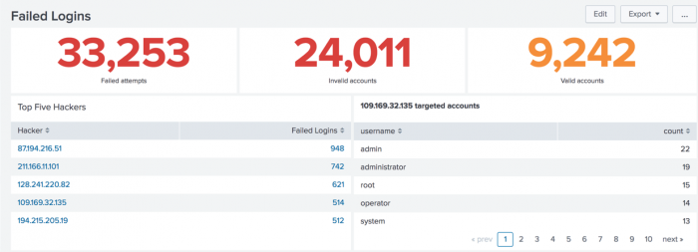
Dashboards
Dashboards integrate real-time searches, charts, reports, gauges, maps, and tables in panels to display the most relevant information for different teams and use cases.
Scheduled searches are used to create real-time dashboards and visualizations.
Some benefits for security analysts and SOC teams include:
Dashboards accelerate time-to-time and time-to-action.
Dashboards use the same event data for security analysts and operations teams to visualize events.

Slide 54
Getting Data into Splunk
There are different methods of getting data into Splunk:
Uploading files (e.g. cvs, json, log, zip) from a system. The maximum size is 500 mb.
Monitoring files and network ports on the host that runs the Splunk instance.
Forwarding data to another Splunk instance or to a third-party system.
Next, we’ll launch into a demo of the workflow for uploading data into Splunk.

Slide 55
Uploading a Web Log into Splunk
1. Select Source
2. Set Source Type
3. Input Settings
4. Review
5. Upload the Log File

Slide 56
Demo Summary
Uploading a Web Log into Splunk:
We grabbed an existing log file that was created from a different machine.
We uploaded that log file into Splunk.
We can now filter and search for different events based on our customized criteria.
When it comes to searching, quotations after an equals (=) sign are not needed, however adding the quotations makes it easier for others to read your work.

Slide 57
Activity: Uploading a Web Server Log into Splunk
You will be uploading a web server log file into Splunk. This is an important exercise, as you will be uploading various files into Splunk in the coming classes.
Instructions sent via Slack.
10 minutes

Slide 58
Uploading a Web Server Log

Slide 59
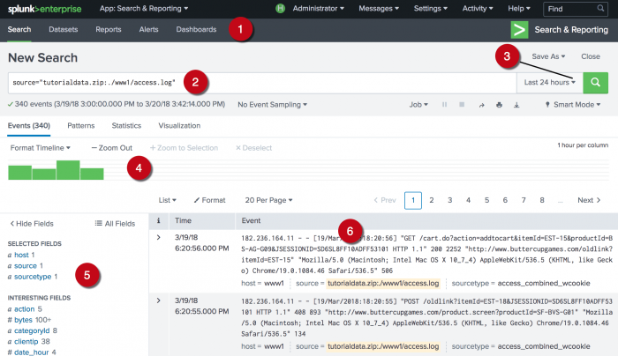
Web Server Log Review
Let’s review the parts of the splunk web server.

Slide 60
Web Server Log Review
1. Application bar contains main functions.
2. Search bar specifies your search criteria.
3. Time range picker specifies the time period for the search.
4. The peaks and valleys in the timeline can indicate spikes in activity or server downtime.

Slide 61
Web Server Log Review
5. Select Fields and Interesting Fields: This sidebar displays a list of the fields discovered in the event.
When you first run a search, the Selected Fields list contains the default fields host, source, and source type.
Interesting Fields are fields that appear in at least 20% of the events.

Slide 62
Web Server Log Review
6. Events viewer displays the events that match your search.
By default, the most recent event is listed first and the matching search terms are highlighted.

Slide 63
Search Processing Language

Slide 64
So far we've looked at the basic functions of the Search and Reporting App and how to upload a weblog into Splunk and generate events.
Now, it’s time to search events using the Search Processing Language (SPL).

Slide 65
Using SPL to Retrieve Events

Slide 66
The Anatomy of a Search
Search Processing Language (SPL) is a language based on the Unix Pipeline and the Standard Query Language (SQL).
When working with SPL:
We are seeking to match search terms against segments of the data in order to return events from indexes.
Search terms use keywords, field name and value pairs, boolean expressions, logical / relational operators and wildcards that specify which events we want to retrieve from the indexes.

Slide 67
Keywords
Keywords are fields that have been automatically extracted from the log file that can be used for searches.
These keywords are chosen based on the frequency they appear in the log file.
Keywords are also known as selected and interesting fields in Splunk and appear on the left hand side of the search page.
On the right side of the field, we can see the number of instances each field shows up in the log file. This is useful when conducting searches.

Slide 68
Field / Value Pairs
Field / Value Pairs match keywords with the specific information that you are searching for.
Syntax looks like:
<field> = <value>
clientip = 87.194.216.51
Examples include:
user=AJ
This field / value pair would find the user named AJ.
domain=facebook.com
This pair would find the website facebook.

Slide 69
Logical Operators and Boolean Expressions
Three boolean expressions that we covered in the past are applicable in Splunk
NOT: "I want all instances of the error 403 NOT forbidden access" :
I only want to see error 403 that are not also errors of forbidden access.
OR: "I want all instances of the errors 403 OR forbidden access" :
I want to see singular instances of one or the other, but not both.
AND: “I want all instances of the errors 403 AND forbidden access":
I want both errors.

Slide 70
Relational Operators
Splunk also uses relational operators
Not Equals Operator:
!= 200
“I want all events where the status does not equal to 200”
Greater Than Operator:
> 4
“I want all events where the line count is greater than 4”

Slide 71
Wildcards and Boolean Expression
Wildcards use the symbol “*” to match any character in that string”:
“you*” would match with you’re, young, your, youth
“*ing” would match with matching, fighting, talking
“*each*” would match with reaching, breach, preach
Wildcards are used in the same way that they are used when operating a Linux machine.

Slide 72
Boolean Expression Demo

Slide 73
Splunk Searching
Key Takeaways:
Machine data that comes into Splunk is unruly and unorganized.
Keywords, wildcards, and filed / value pairs allow us to filter the data.
Boolean expressions take our filtration techniques a step further, to more precisely receive what we need.

Slide 74
Student Activity: Introduction to SPL
In this activity, you will practice writing and implementing a simple SPL statement that uses field/value pairs, boolean expressions, and fields.
Instructions sent via Slack.
15 Minutes

Slide 75
Introduction to SPL

Slide 76
Introduction to SPL Review Part 1
1. What is an event?
2. What is a source type?
3. What is the most important search parameter to specify?
4. Identify what this search will do: src="10.9.165.*" OR dst="10.9.165.8"

Slide 77
Introduction to SPL Review Part 1
1. What is an event?
Events are a single record of activity or instance data that has been indexed by Splunk.
For example, a single log entry in a log file might be an event.
2. What is a source type?
3. What is the most important search parameter to specify?
4. Identify what this search will do: src="10.9.165.*" OR dst="10.9.165.8"

Slide 78
Introduction to SPL Review Part 1
1. What is an event?
Events are a single record of activity or instance data that has been indexed by Splunk.
For example, a single log entry in a log file might be an event.
2. What is a source type?
Splunk assigns a source type to determine how to format the event data during the indexing process.
3. What is the most important search parameter to specify?
4. Identify what this search will do: src="10.9.165.*" OR dst="10.9.165.8"

Slide 79
Introduction to SPL Review Part 1
1. What is an event?
Events are a single record of activity or instance data that has been indexed by Splunk.
For example, a single log entry in a log file might be an event.
2. What is a source type?
Splunk assigns a source type to determine how to format the event data during the indexing process.
3. What is the most important search parameter to specify?
Time
4. Identify what this search will do: src="10.9.165.*" OR dst="10.9.165.8"

Slide 80
Introduction to SPL Review Part 1
1. What is an event?
Events are a single record of activity or instance data that has been indexed by Splunk.
For example, a single log entry in a log file might be an event.
2. What is a source type?
Splunk assigns a source type to determine how to format the event data during the indexing process.
3. What is the most important search parameter to specify?
Time
4. Identify what this search will do: src="10.9.165.*" OR dst="10.9.165.8"
Returns events where the source IP addresses that start with 10.9.165 or destination IP address is 10.9.165.8.

Slide 81
Introduction to SPL Review: Part 2
For the search, provide the following:
The field / value pairs:
source=“access_30DAY.log”
sourcetype=“access_combined_wcookie”
status=“505”
The boolean operator:
The boolean expression

Slide 82
Introduction to SPL Review: Part 2
For the search, provide the following:
The field / value pairs:
The boolean operator:
The boolean expression

Slide 83
Introduction to SPL Review: Part 2
For the search, provide the following:
The field / value pairs:
source=“access_30DAY.log”
sourcetype=“access_combined_wcookie”
status=“505”
The boolean operator:
The boolean expression

Slide 84
Introduction to SPL Review: Part 2
For the search, provide the following:
The field / value pairs:
source=“access_30DAY.log”
sourcetype=“access_combined_wcookie”
status=“505”
The boolean operator: AND
The boolean expression

Slide 85
Introduction to SPL Review: Part 2
For the search, provide the following:
The field / value pairs:
source=“access_30DAY.log”
sourcetype=“access_combined_wcookie”
status=“505”
The boolean operator: AND
The boolean expression
source=“access_30DAY.log” sourcetype= “access_combined_wcookie” AND status=“505”

Slide 86
Introduction to SPL Review Part 3
1. Write the search term that will first display events for ALL server response errors.

Slide 87
Introduction to SPL Review Part 3
1. Write the search term that will first display events for ALL server response errors.
This search requires a wildcard to specify the *5xx family of the HTTP server responses.
source=“access_30DAY.log” sourcetype=“access_combined_wcookie” AND status=”5**”
2. Next, narrow your search down to HTTP versions not supported events.

Slide 88
Introduction to SPL Review Part 3
1. Write the search term that will first display events for ALL server response errors.
This search requires a wildcard to specify the *5xx family of the HTTP server responses.
source=“access_30DAY.log” sourcetype=“access_combined_wcookie”AND status=”5**”
2. Next, narrow your search down to HTTP versions not supported events.
source=“access_30DAY.log” sourcetype=“access_combined_wcookie” AND status=“505”

Slide 89
Introduction to SPL Review Part 3
3. Now, isolate the highest client software that is originating the response:

Slide 90
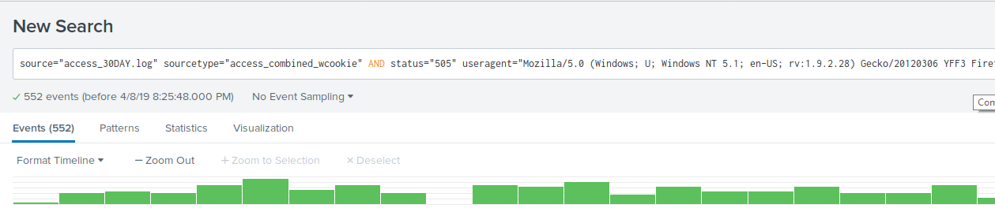
Introduction to SPL Review Part 3
3. Now, isolate the highest client software that is originating the response:
Use Interesting Fields and select the highest value from the useragent field.

Slide 91
Introduction to SPL Review Part 3
4. Record the number of events that are returned.
5. Record the peak times when the events occur.

Slide 92
Introduction to SPL Review Part 3
4. Record the number of events that are returned.
552
5. Record the peak times when the events occur.
Peak times will vary.

Slide 93
Class Objectives
By the end of class today, students will be able to:
Recognize the role SIEMs play in protecting an organization's security.
Explain how logs are filtered, normalized, and correlated for events.
Use basic features of the Splunk User Interface.
Explain basic database terms and query functions.
Use the Splunk Processing Language (SPL) for simple queries.

